Slide 1


Project name: FET Control Box For ECEN Power Electronics Class Team members: Luke, Max, Sydney, Jacky
ECEN 403

Slide 2
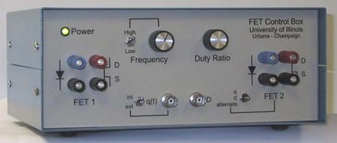
Project description
Problem Statement:
The FET box was created to aid in power electronics education (i.e. ECEN 438) and research. However, it was designed in 2003, so replacement parts cannot be ordered due to no longer being manufactured.
Solution Proposal:
Modernize the previous design while keeping the design robust and easy to use.
Add new features and improve upon existing features.

Slide 3
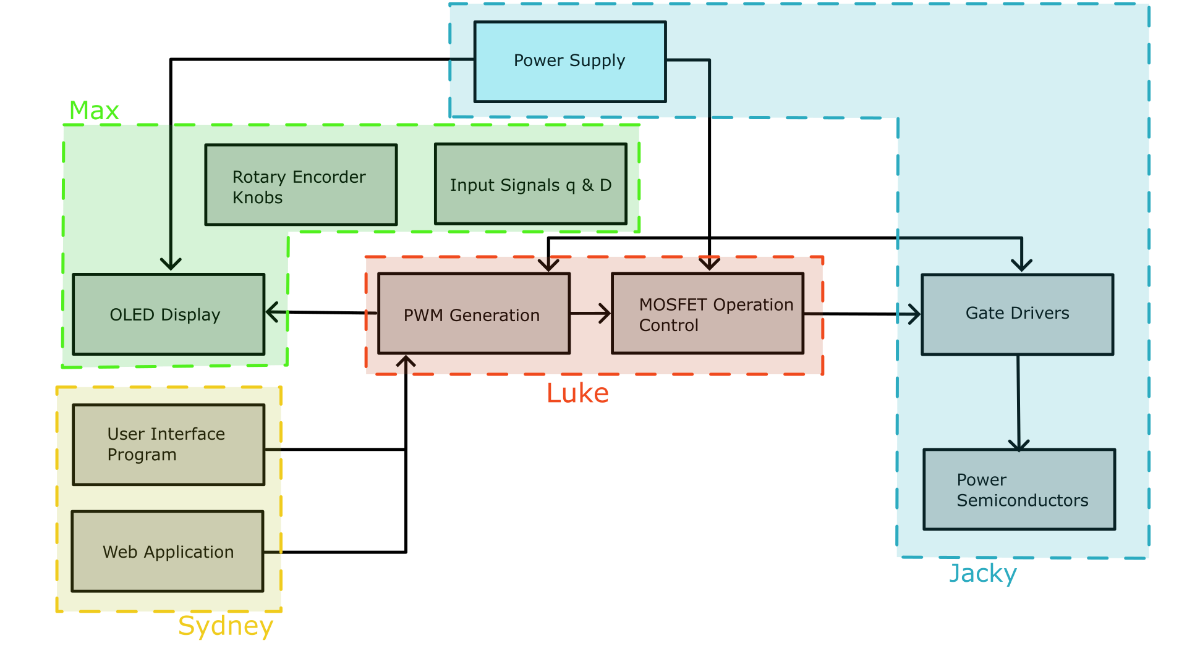
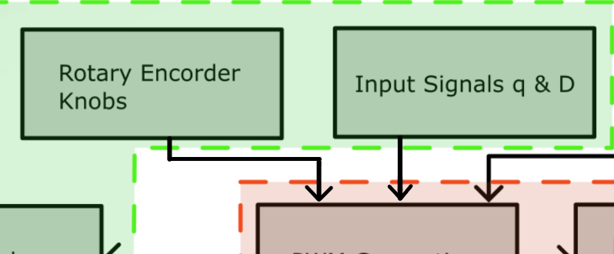
Diagram of subsystems and interface

Slide 4
Power Supply and Gate Drivers Subsystem
Power Supply:
Supplies the electrical components with power.
Converts the power supplied by the wall to 12VDC 10A.
Flyback inductor to reduce EMI.
Gate Drivers:
Gate drivers provide low impedance current drive to the flyback FETs.
Gives high speed switching for the FETs.

Slide 5
Power Supply Subsystem
Jacky Chen
Current Accomplishments | Ongoing progress/problems and plans until the next presentation
Conops FSR, ICD, execution plan, and validation plan Completed subsystem intro project Midterm presentation | Upcoming week Start breadboarding/simulating power supply and gate driver design Find new parts to replace old parts Future Plans Implement designs into PCB

Slide 6
User Interface and Web Application Subsystem
User Interface
Replacing LabView
SCPI commands through Command Expert on Excel
Commonly used in Industry and Classroom
Macros will help automate commands, collect data, and create reports in one place
Web Application
using Winforms through Visual Studio
integrate Excel data into Winforms
Students can visualize the mathematical and graphical analysis of their Lab in one place
Students can explore patterns and trends with more data points than collected in Lab

Slide 7
UI & Application Subsystem
Sydney Naddy
Current Accomplishments | Ongoing progress/problems and plans until the next presentation
Conops FSR, ICD, execution plan, and validation plan Completed subsystem intro project Midterm presentation Researched SCPI commands and Winforms | Upcoming week Finalize how to implement SCPI commands with sponsor Continue working on Winform buttons Future Plans Organize process for UI & application implementation Start writing SCPI commands Gather all mathematical formulas, equations, analysis needed for application

Slide 8
Microcontroller Subsystem
PWM Generation
Generate signal with given duty ratio and frequency specified by either analog or digital inputs
Adjustable frequency range (1kHz to 300kHz) and duty ratio (5% to 95%)
FET Operation Control
Ability to switch the two mosfets between three different modes: Matching, alternating, and complimentary.

Slide 9
Microcontroller Subsystem
Luke Bethancourt
Current Accomplishments | Ongoing progress/problems and plans until the next presentation
Conops FSR, ICD, execution plan, and validation plan Completed subsystem intro project Midterm presentation | Upcoming week Developing firmware - PWM signal generation - FET dead time logic Future Plans FET operation controls Interaction with SCPI commands and web application Microcontroller PCB design

Slide 10
I/O Subsystem
Frequency and Duty Cycle Adjustment Knobs
2 rotary encoders to control frequency and duty cycle
“Coarse” and “Fine” adjustment mode
Fast turning of knob coarsely changes value
Slower turning of knob finely changes value
OLED Display
Information to be displayed:
Frequency
Duty Cycle
Operation Mode
Internal or external PWM in use

Slide 11
I/O Subsystem
Max Garza
Current Accomplishments | Ongoing progress/problems and plans until the next presentation
Conops FSR, ICD, execution plan, and validation plan Completed subsystem intro project Midterm presentation | Upcoming week: Part Selection Start writing firmware for rotary encoders Validate basic function of rotary encoders Future Plans Implement “coarse” and “fine” adjustment feature of rotary encoders Start on OLED display UI design

Slide 12
Task partition
Jacky: Power Supply and Gate Drivers.
Luke: PWM Generation and FET Operation Control
Max: OLED Display and Rotary Encoder Knob Implementation
Sydney: User Interface and Web Application

Slide 13
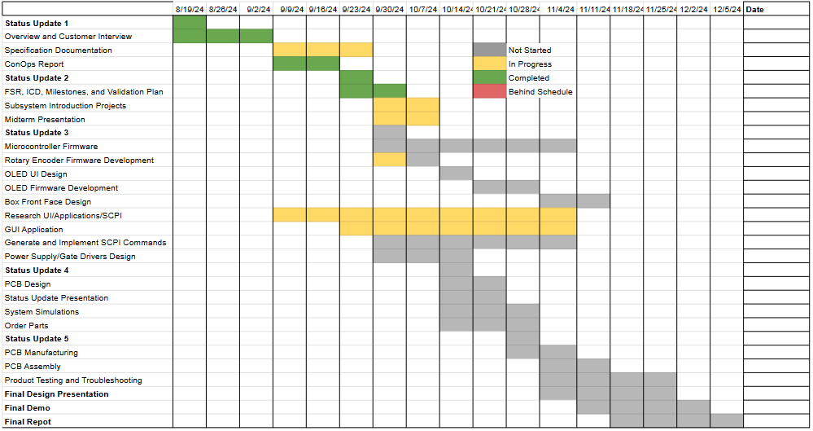
Execution plan

Slide 14
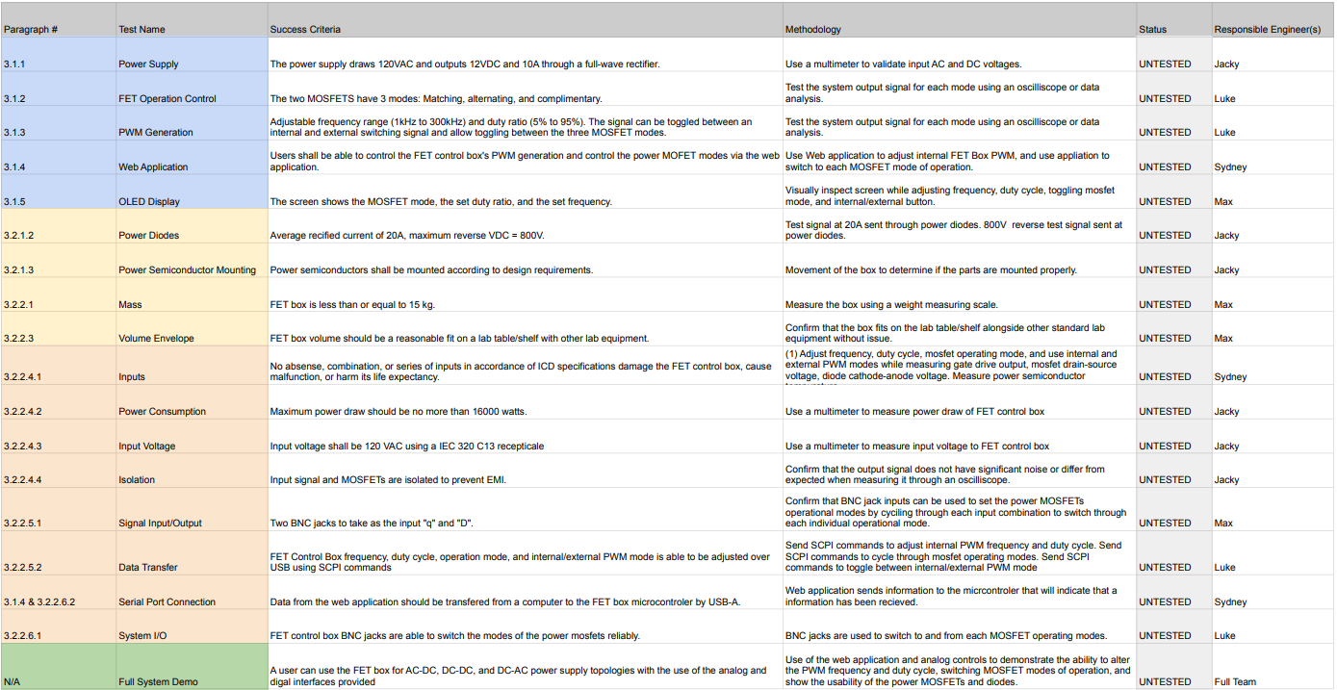
Validation plan

